Slide 1

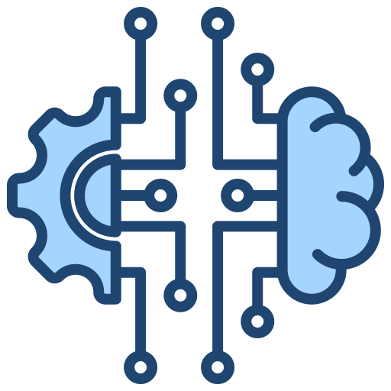


Deep Learning

Slide 2

Problem Statement:
What will we accomplish in this workshop, and at what point does Deep Learning become relevant?

Slide 3

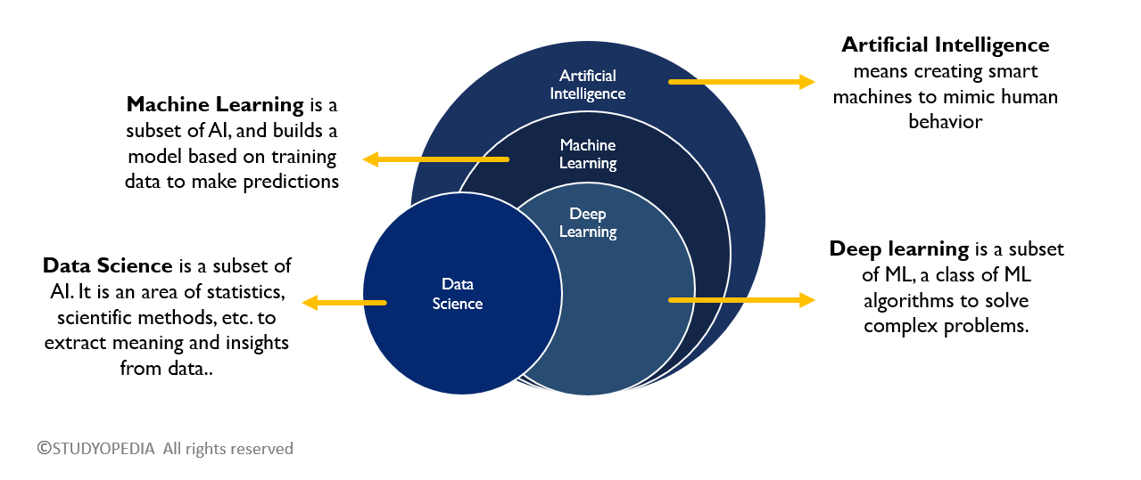
The AI Landscape: Data Science

Slide 4
Artificial Intelligence (AI)
Definition: AI is a broad field of computer science focused on building systems that can perform tasks that normally require human intelligence such as reasoning, problem-solving, decision-making, and natural language understanding.
Goal: To make machines think and act intelligently.
Examples:
Siri / Alexa / Google Assistant – understanding and responding to voice commands.
Self-driving cars – deciding when to stop, turn, or accelerate.
ChatGPT – understanding natural language and giving human-like responses.
Note: AI is the umbrella term that includes Machine Learning and Deep Learning.

Slide 5
Machine Learning (ML)
Definition: ML is a subset of AI that enables machines to learn from data and improve over time without being explicitly programmed.
Goal: To make machines improve their performance automatically with experience.
Examples:
Email spam filters – ML learns from past emails to detect spam.
Netflix / YouTube recommendations – ML studies your watch history to suggest shows or videos.
Credit card fraud detection – ML detects unusual spending patterns.
Note: In ML, humans still have to manually select features (important data points) for training models.

Slide 6
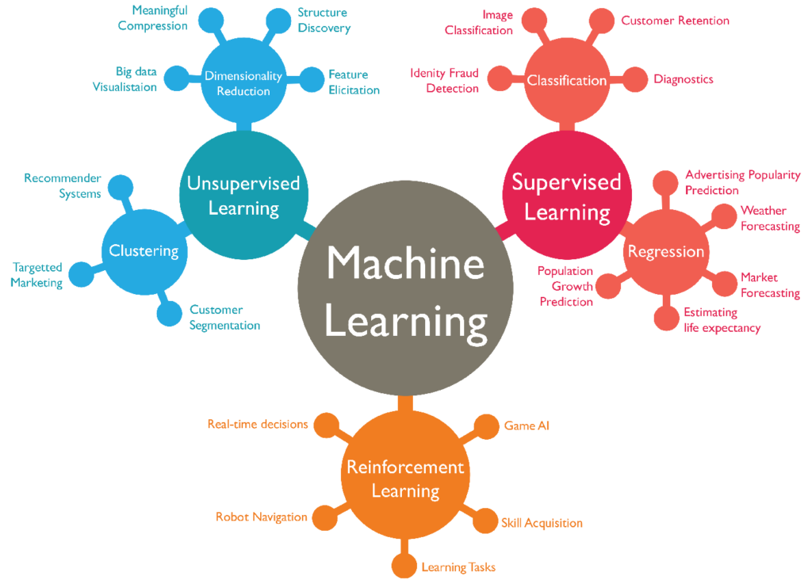

Slide 7
Deep Learning (DL)
Definition: DL is a subset of ML that uses Artificial Neural Networks (ANNs) with many layers (hence “deep”). It automatically learns features from raw data like text, images, and sound.
Goal: To enable machines to handle very large and complex datasets with minimal human intervention.
Examples:
Face recognition on smartphones – DL identifies unique facial features automatically.
Self-driving cars – DL processes camera input to detect pedestrians, lanes, and traffic signs.
Google Translate – DL understands and translates between languages.
Medical diagnosis – DL models detect diseases from X-rays, MRIs, etc.
Note: DL removes the need for manual feature selection – it learns features by itself.

Slide 8
Quick Analogy (Real-World Example): Imagine teaching a child to recognize a dog:
AI: You tell the child "This is a dog. When you see something like this, call it a dog."
ML: You give the child lots of dog pictures. The child learns patterns (fur, ears, tail) and can recognize a new dog.
DL: The child doesn’t just look for “fur” or “tail.” Instead, their brain (neural network) automatically figures out complex features (shape, eyes, nose, breed differences).

Slide 9
Introduction to Deep Learning and Neural Networks

Slide 10
What is Deep Learning?
Deep Learning is a branch of Machine Learning that uses artificial neural networks with many layers (hence "deep") to learn from data and make predictions or decisions.
Neural Networks:
A Neural Network (NN) is a computational model inspired by the way the human brain works. It consists of layers of interconnected "neurons" (also called nodes), and it is used to recognize patterns, make decisions, and learn from data.
Neural networks are the foundation of Deep Learning, a subset of Machine Learning.

Slide 11
Why ANN:
Machine learning, as we have seen, mimics the human form of learning. On the other hand, human learning, or for that matter every action of a human being, is controlled by the nervous system.
In any human being, the nervous system coordinates the different actions by transmitting signals to and from different parts of the body.
The nervous system is constituted of a special type of cell, called neuron or nerve cell, which has special structures allowing it to receive or send signals to other neurons. Neurons connect with each other to transmit signals to or receive signals from other neurons. This structure essentially forms a network of neurons or a Neural Network.

Slide 12
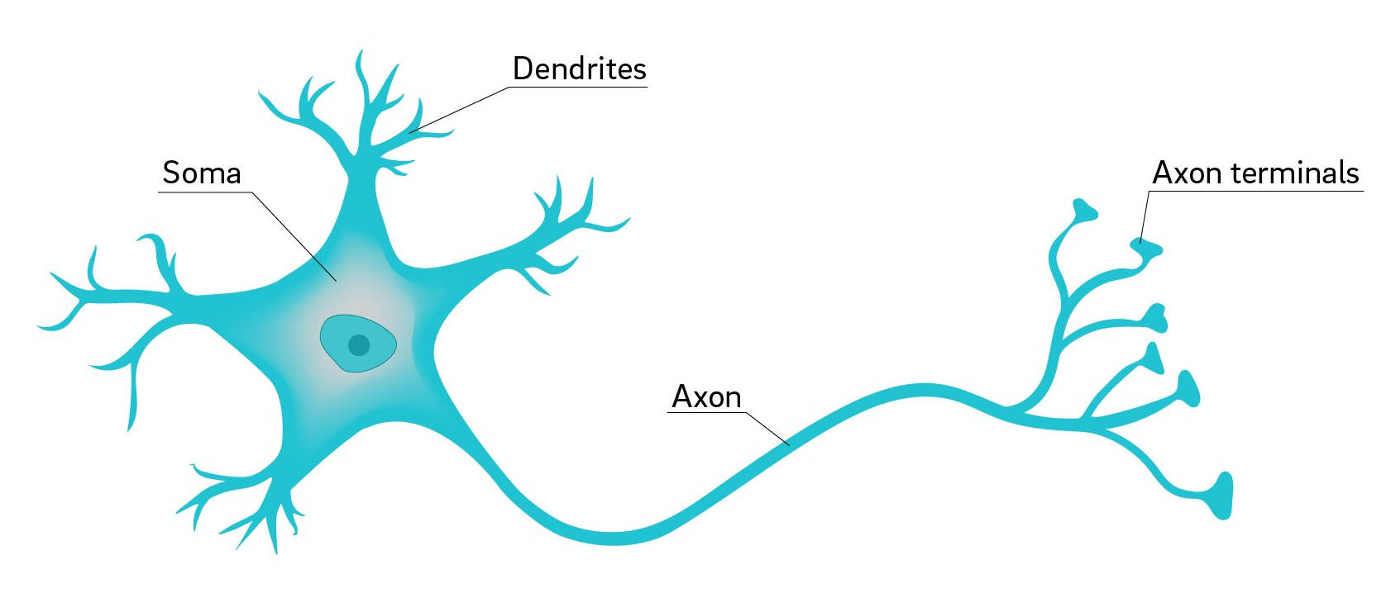
THE BIOLOGICAL NEURON : The human nervous system is divided into two main parts:
The Central Nervous System (CNS): which includes the brain and spinal cord.
The Peripheral Nervous System: which includes nerves and ganglia (clusters of nerve cells) outside the brain and spinal cord.
Structure of a 1 Neuron

Slide 13
Why Understand Biological Neural Networks?
For creating mathematical models for artificial neural networks, theoretical analysis of biological neural networks is essential as they have a very close relationship. And this understanding of the brain’s neural networks has opened horizons for the development of artificial neural network systems and adaptive systems designed to learn and adapt to the situations and inputs.

Slide 14
Artificial Neuron or Perceptron :
An artificial neuron, often referred to as a perceptron, is a fundamental building block of artificial neural networks (ANNs). Modeled after biological neurons in the human brain, artificial neurons are mathematical entities designed to process and transmit information.
The biological neural network has been modelled in the form of ANN with artificial neurons simulating the function of biological neurons.
Artificial Neural Network (ANN): An artificial neural network (ANN), often simply referred to as a neural network, is a computational model inspired by the structure and function of biological neural networks in the human brain. It consists of interconnected nodes, called neurons or units, organized in layers. ANN processes information in a manner similar to how the human brain operates, enabling it to learn from data and make predictions or decisions.
Key components and concepts of an ANN:
Neurons (Nodes)
Connections (Edges)
Layers

Slide 15
Artificial Neural Networks: ANN
The human brain works like a supercomputer, allowing us to make quick decisions and perform complex actions. For example, think about a cricket fielder making a great catch. They have to calculate where the ball will land, how fast it's moving, and then decide when and where to jump to catch it. This requires a lot of skill and quick thinking.
Even simpler tasks, like swimming in a pool, require a lot of coordination and decision-making. Your brain has to figure out the right body movements and breathing techniques to swim effectively, especially since water is much denser than air. Despite these challenges, our brains are able to handle these tasks because of their complex network of neurons, which allow us to process information and make decisions quickly.
This amazing ability of our brains has inspired the creation of Artificial Neural Networks (ANN). These are like computer models of the brain, made up of artificial neurons. They're designed to mimic how our brains work, using digital versions of neurons to process information and make decisions. These artificial neurons are the basic building blocks of artificial neural networks.

Slide 16
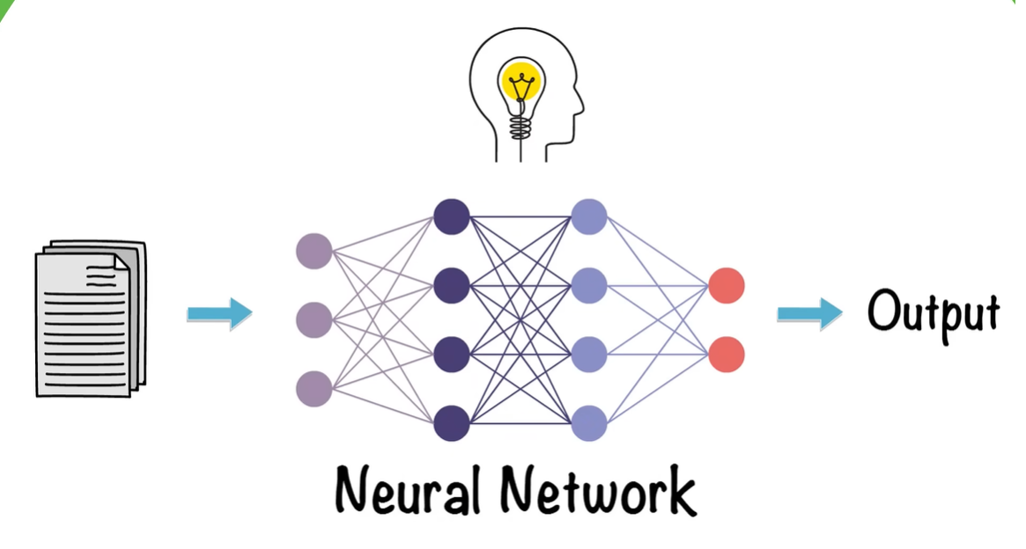
NEURAL NETWORKS:
Neural Networks form the base of Deep Learning, Which is a sub-field of ML where the Algorithms are inspired by the structure of the Human Brain. Neural Networks take in data and train themselves to recognize the patterns in this data and then predicts the output for new set of similar data or unseen data.

Slide 17
Structure of a Neural Network:
Neurons: The basic unit of a neural network. Each neuron receives inputs, processes them, and decides whether to activate (send a signal) using an activation function..
Connections: Links between neurons that transmit information. Each connection has a weight that controls how strongly one neuron influences another.
Weights and Biases: These parameters determine the strength and influence of connections. Weights (w): Multipliers that show the importance of each input. Bias (b): A constant added to shift the decision boundary.
Propagation Functions: Mechanisms that help process and transfer data across layers of neurons. Usually involves an activation function.
Learning Rule: The method by which the network adjusts weights and biases over time (using training data) to reduce errors.

Slide 18
Learning in neural networks follows a structured, three-stage process:
Input Computation: Data is fed into the network.
Output Generation: Based on the current parameters, the network generates an output.
Iterative Refinement: The network refines its output by adjusting weights and biases, gradually improving its performance on diverse tasks.

Slide 19
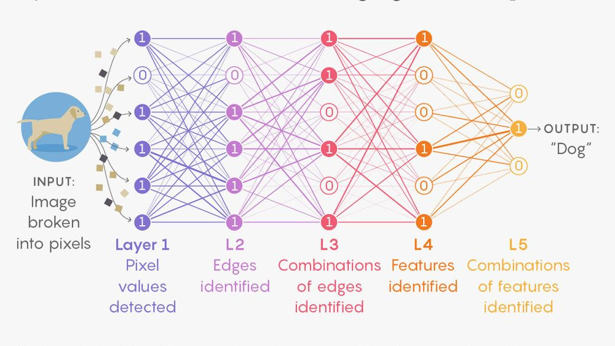

Slide 20
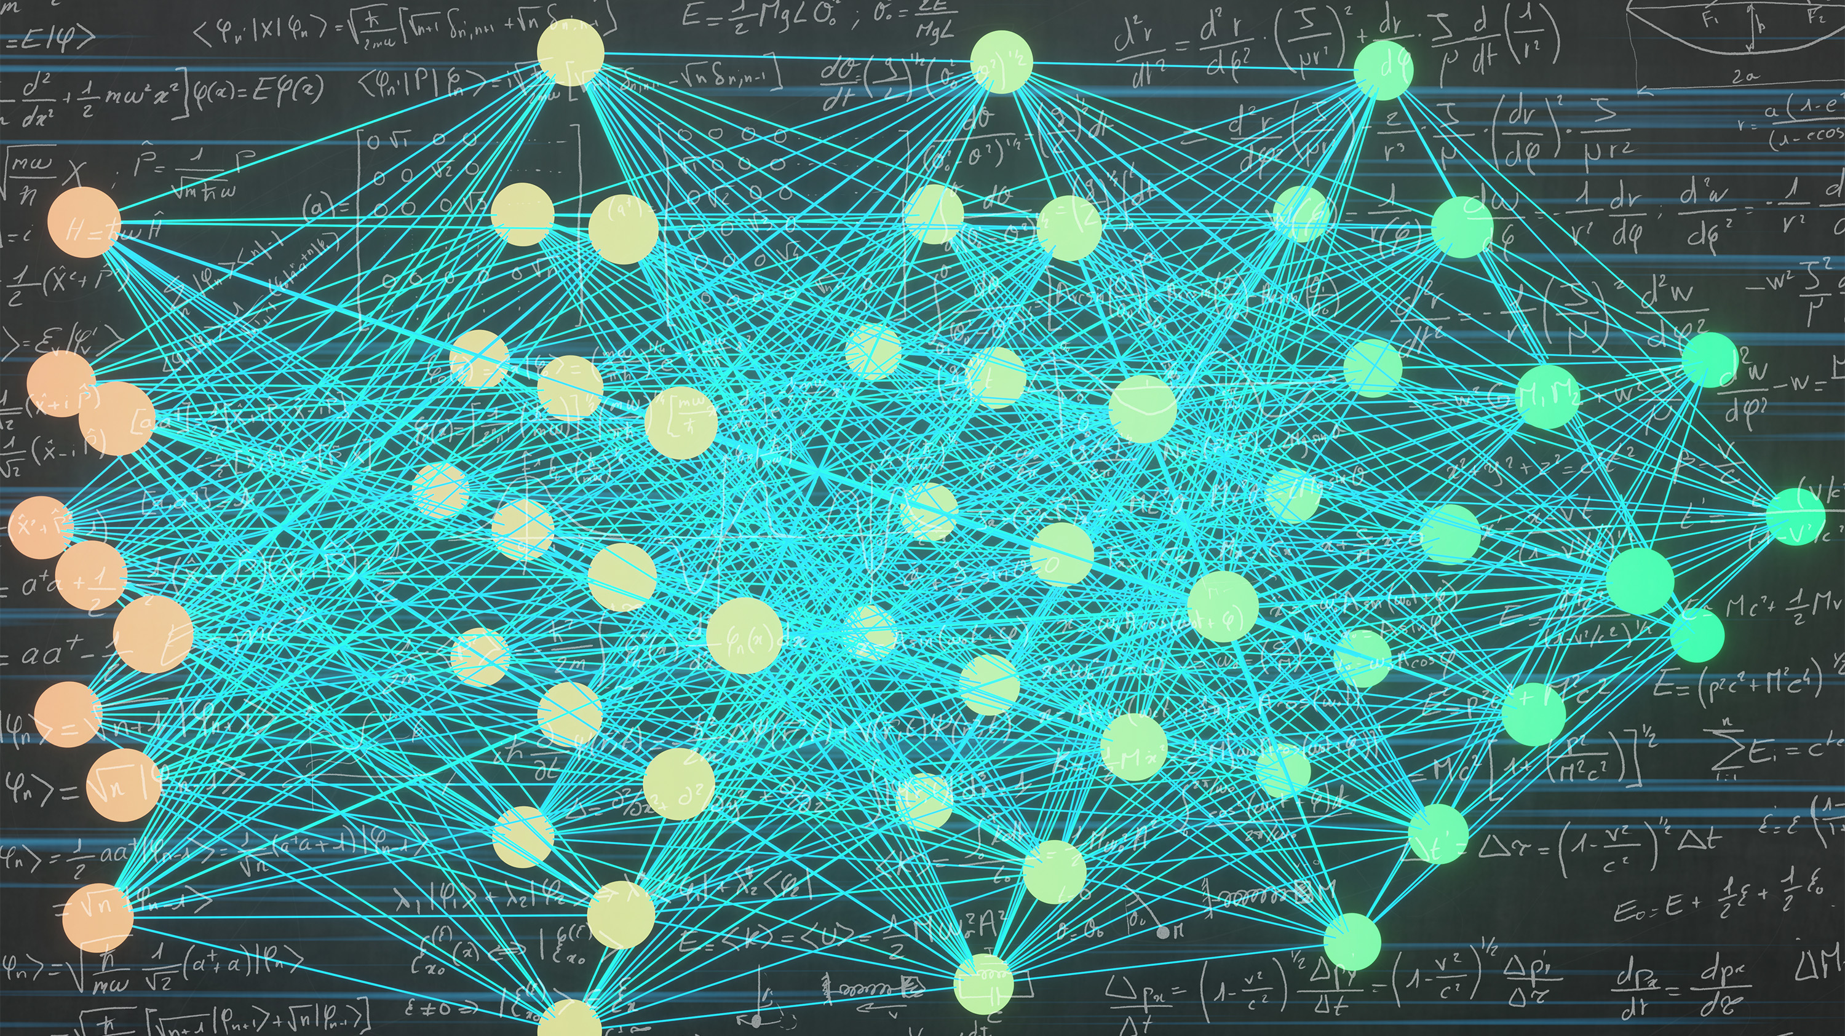

Slide 21
Architecture of an Artificial Neural Network: is a Network of Neurons
The architecture of an artificial neural network (ANN) refers to its structural layout, including the arrangement of neurons (nodes) and the connections between them. The architecture determines how information flows through the network and how computations are performed.
Input Layer
Takes raw data as input.
Each neuron = one feature (e.g., height, weight, pixel value).
Hidden Layers
Perform computations using weights, biases, and activation functions.
Multiple hidden layers = "Deep" learning.
Output Layer
Produces the final result (e.g., classification, prediction).

Slide 22
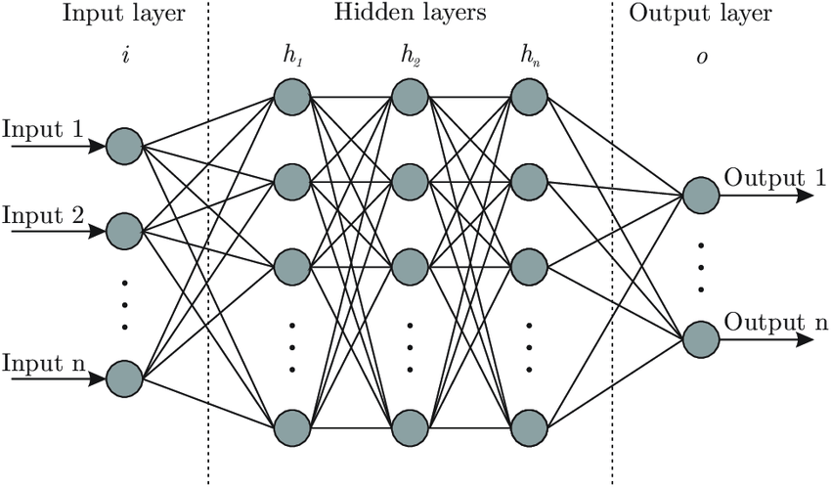

Slide 23
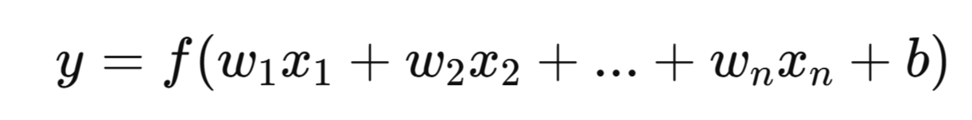
How It Works
Each connection between neurons has:
Weight (w): Importance of the input.
Bias (b): A constant that helps shift the output.
Activation Function: Decides whether a neuron should “fire” (introduces non-linearity).
Formula for a neuron:
where f is the activation function.

